Slide 1
Lead Score Case Study
Members:
Ritesh Shetty
Abhishek Singh

Slide 2
Problem Statement
X Education sells connected to the internet courses to industry professionals.
X Education gets plenty leads, also leads conversion is very weak.For example, if say, they acquire 100 leads in a day, only about 20 of them are converted.
If we want more efficient on this process ,the corporates wishes to identify ultimate leads, also known as Hot leads
For identify the set of leads will be successful the lead conversion rate should go up as the sales team will now be focusing more on communicating with the potential leads rather than making calls to everyone

Slide 3
Business Objective
Most Promising leads wants to know by X education
While build up a Model to identifies the hot leads
Deployment of the model for the future use

Slide 4
Solution Methodology
Data cleaning and data manipulation.
Check and handle duplicate data
Check and handle NA values and missing values
Drop columns, if it contains high values of missing amount and not useful for the analysis
Imputation of the amounts, if necessary
Check and handle outliers in data

Slide 5
EDA
Univariate data analysis: value count, distribuion of variable etc
Bivariate data analysis: correlation coefficients and pattern between the variables etc
Encoding of the data and Dummy variables & Feature Scaling
Classification of technique: For model making and prediction are used by logistic regression
Validation of the model
Model presentation
Conclusions and recommendations

Slide 6
DATA MANIPULATION
Total Number of Rows =37, Total Number of Columns =9240.
Single value features like “Magazine”, “Receive More Updates About Our Courses”, “Update me on Supply”
Chain Content”, “Get updates on DM Content”, “I agree to pay the amount through cheque” etc. have been dropped.
Removing the “Prospect ID” and “Lead Number” which is not necessary for the analysis.
After checking for the value counts for some of the object type variables, we find some of the features which has no enough variance, which we have dropped, the features are: “Do Not Call”, “What matters most to you in choosing course”, “Search”, “Newspaper
Article”, “X Education Forums”, “Newspaper”, “Digital Advertisement” etc.
Dropping the columns having more than 35% as missing value such as ‘How did you hear about X Education’ and ‘Lead Profile’.

Slide 7
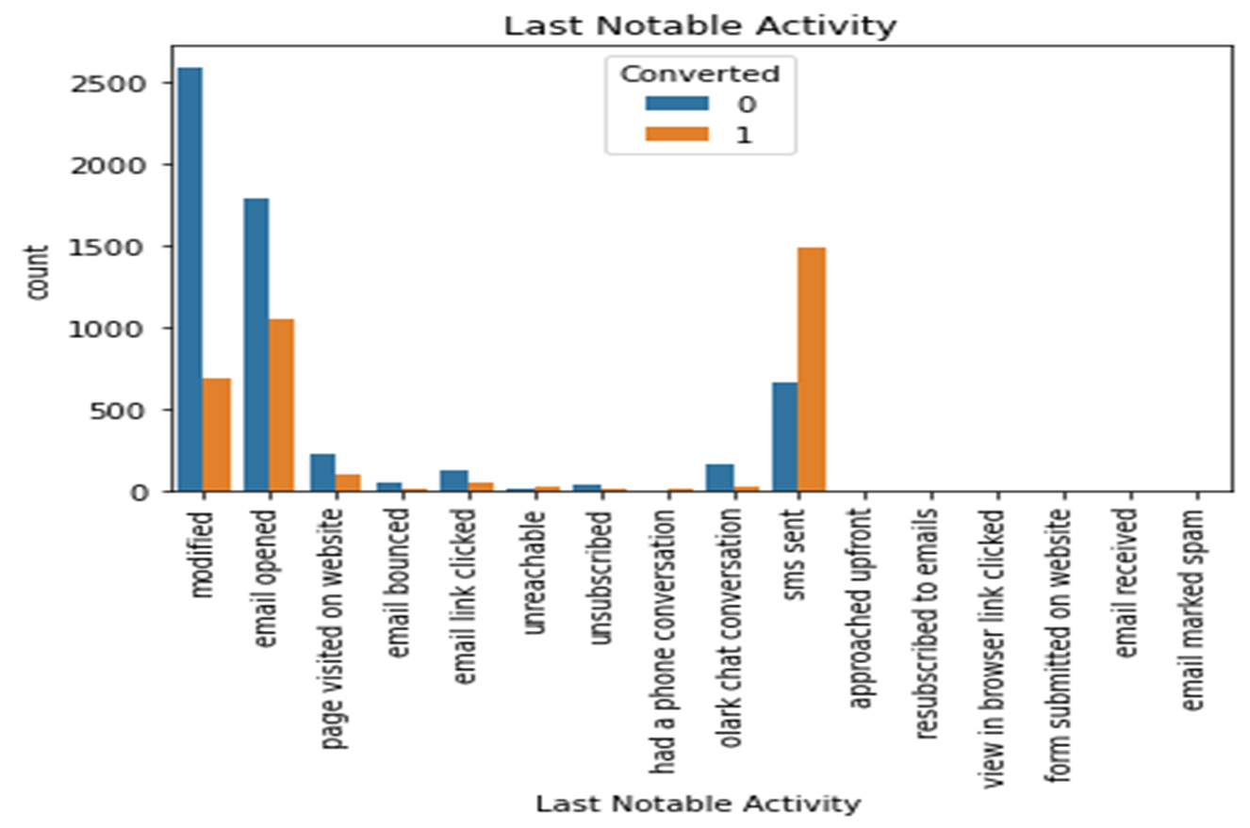
EDA

Slide 8
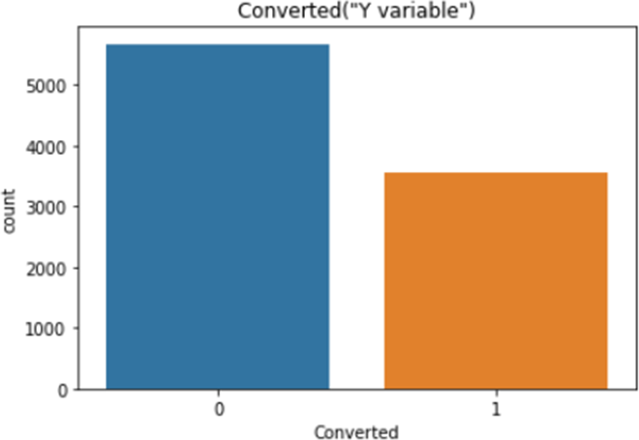
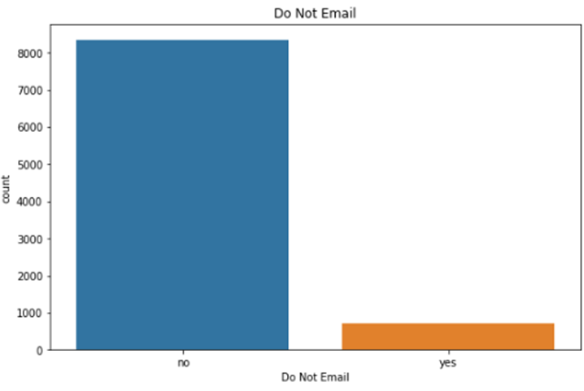
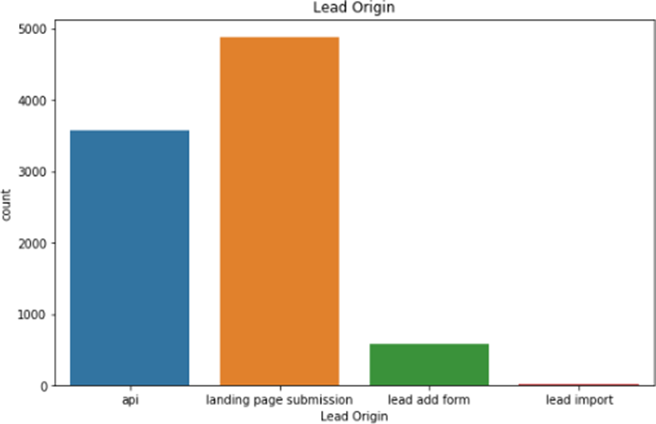

Slide 9
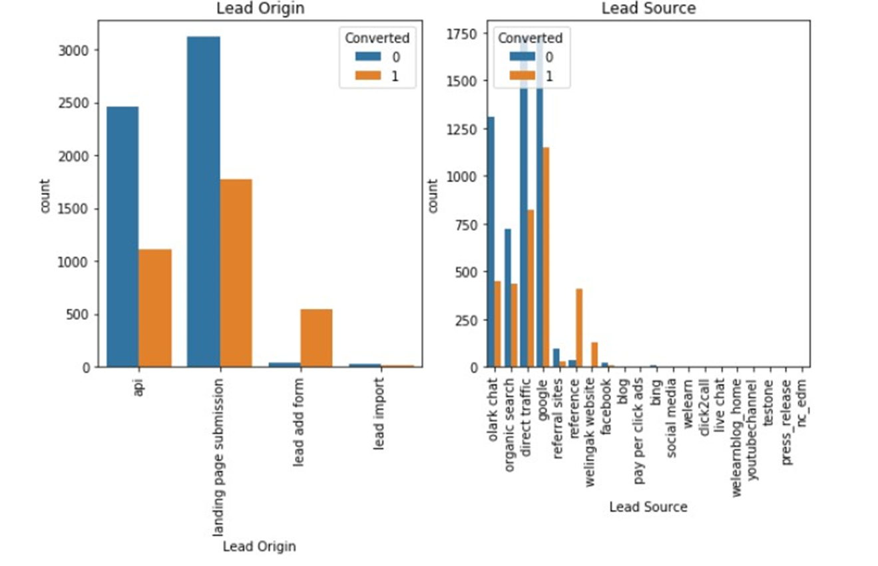

Slide 10
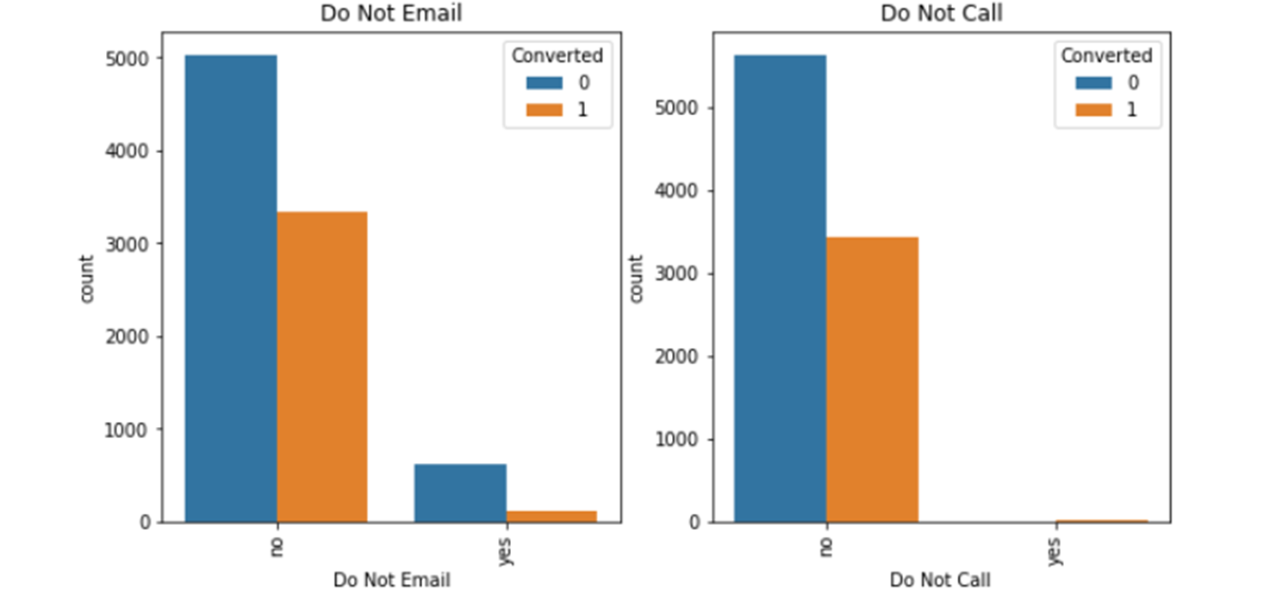

Slide 11
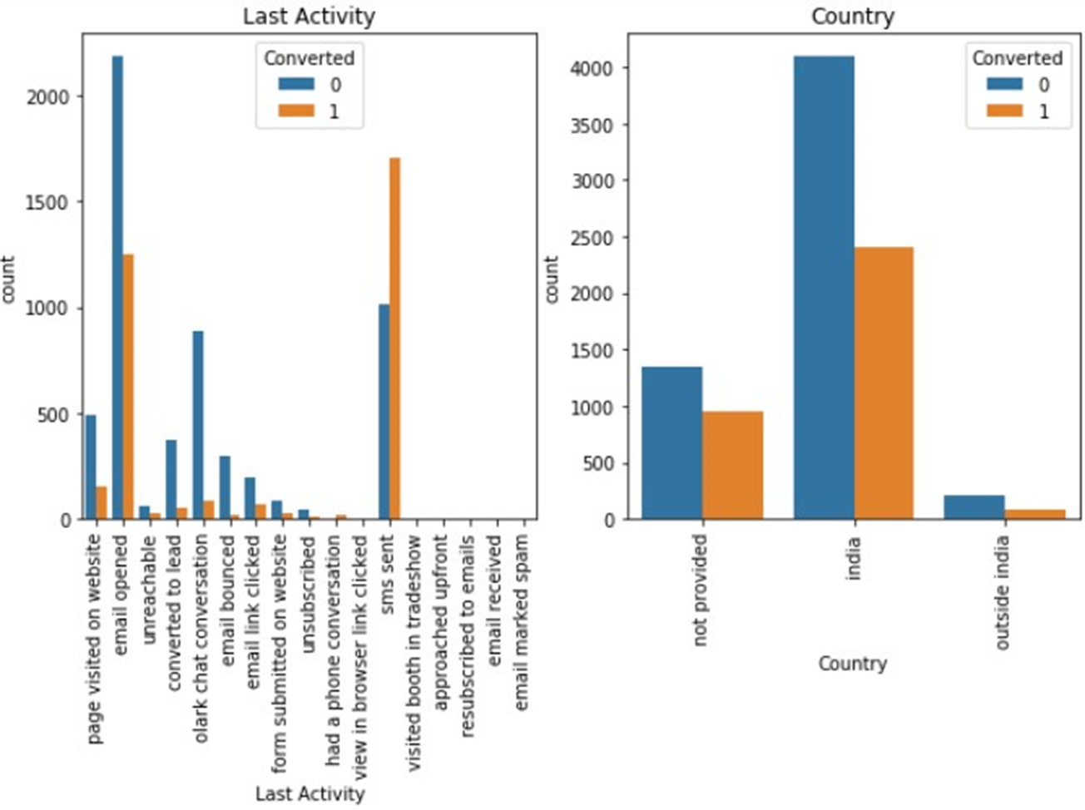

Slide 12
Data Conversion
Numerical variables are normalised
Dummy Variables are created for object type variables
Total rows for analysis: 8792
Total columns for analysis: 43

Slide 13
Model Building
Splitting the data into Training and Testing Sets
First basic step for regression is performing a train-test split, we have chosen
Use RPE for Feature Selection
Running RPE with variables as output
Building Model by removing the variable whose p-value is greater than and vif value is greater than
Predictions on test data set
Overall accuracy

Slide 14
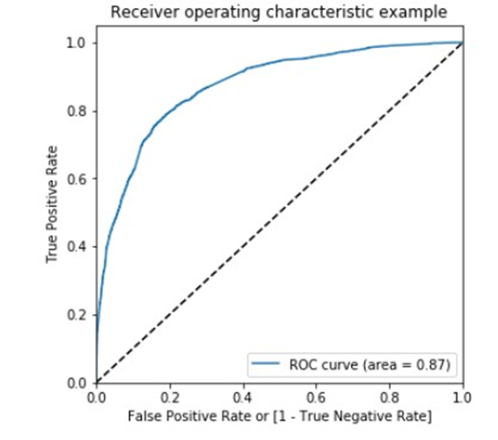
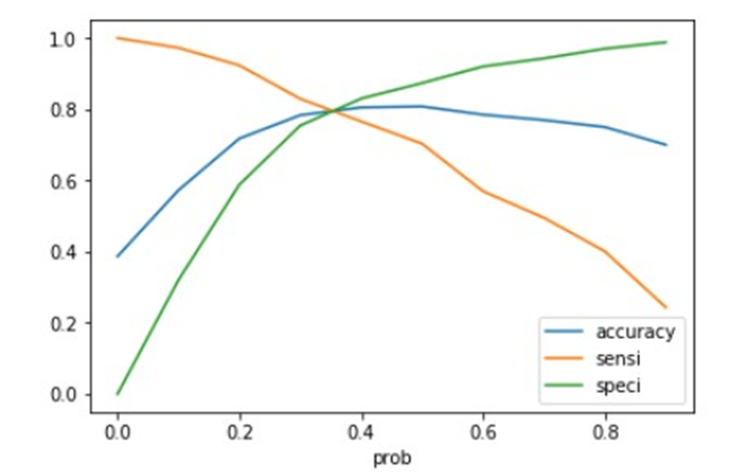
ROC CURVE
Finding Optimal Cut off Point
Optimal cut off probability is that
probability where we get balanced sensitivity and specificity.
From the second graph it is visible that the optimal cut off is at 0.35

Slide 15
Conclusion
It was found that the variables that mattered the most in the potential buyers are (In descending order) :
The total time spend on the Website.
Total number of visits.
When the lead source was:
a.Google
b.Direct traffic
c.Organic search
d.Welingak website
When the last activity was:
a.SMS
b.Olark chat conversation

